Slide 1
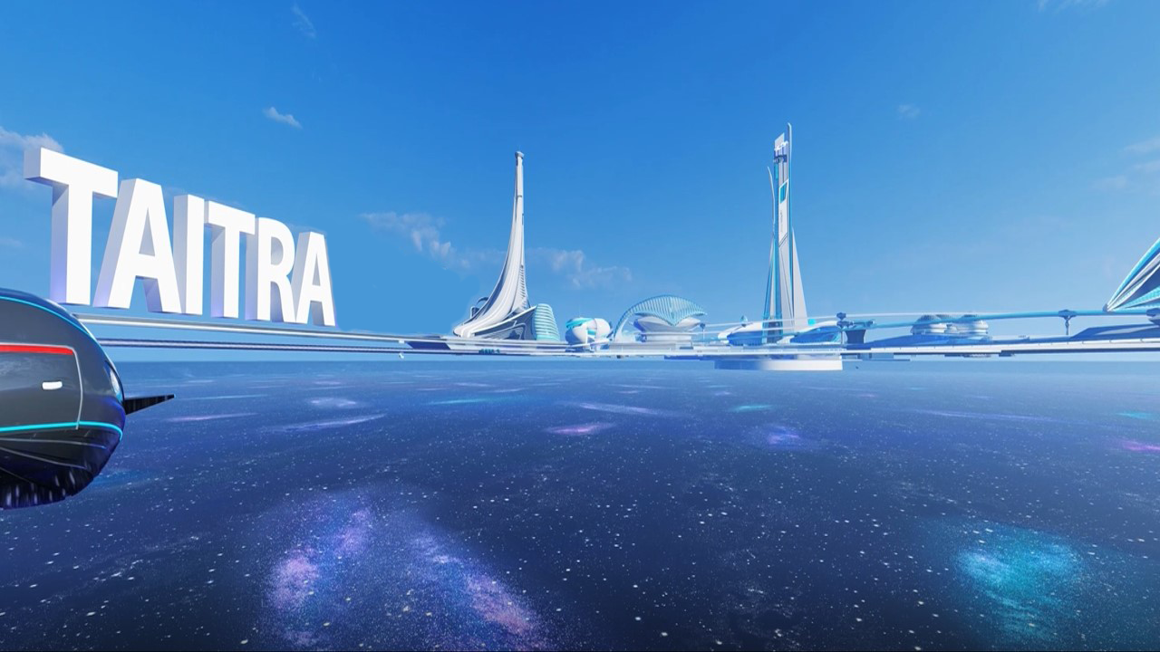
Taiwan Trade Center, Sofia
Presentation to Chamber of Commerce and Industry, Burgas
Oct 12, 2023

Slide 2






Introduction
Taiwan Population
23.4 M
Taiwan Land Area
36,191 KM²
Similar to
Similar to
Australia Population
24.6 M
Netherlands
33,893 KM²
Belgium
30,528 KM²

Slide 3
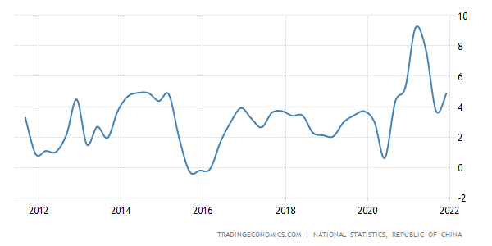
Strong Economic Performance
1
22nd largest economy in the world (2021)
Taiwan was the only Asian Tiger that reported 6.45% GDP growth 2021 in Asia Pacific region.
Ranked No. 8 by IMD World Competitiveness Yearbook 2021, huge progress in domestic economy and international trade.
Taiwan GDP Annual Growth Rate (in %)

Slide 4

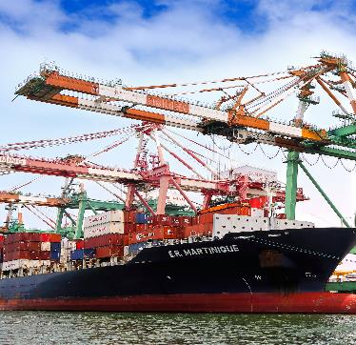



2
TAIWAN INDUSTRIES

Slide 5
ICT and IOT
Hand Tools
INDEX
Machinery
Fasteners
Bubble Tea
Automobile(EV)
Halal
Bicycle
Metaverse Ecosystem
Textiles
Franchising

Slide 6
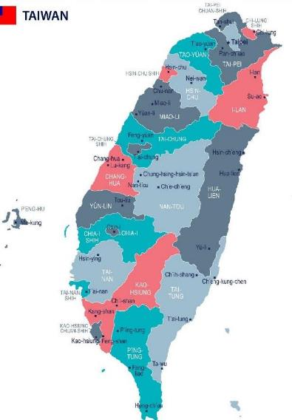
5
High Performing Industrial Clusters
Hsinchu
ICT / IOT
Semi Conductor
Bio Tech
Taipei
EV
IC Design
Digital
Taichung
Smart Machinery
Bicycle
EV
Optoelectronics
Green Energy
Recycle
Taoyuan
Textile
Kaohsiung
Fastener
Shipbuilding
Petrochemical
Steel
Communication
Tainan
Green Energy
Auto Parts
Optoelectronics

Slide 7

IOT - Semiconductor
TSMC+UMC+PSMC+VIS=63.8%
Top 1 worldwide
Taiwan
the unmatched leader of the
global semiconductor industry
TSMC Ranked 1st with an estimated market share of 53.1%
Top 3 foundries by revenue: TSMC, Samsung, UMC
Source: TrendForce Dec. 2021
7

Slide 8




Slide 9
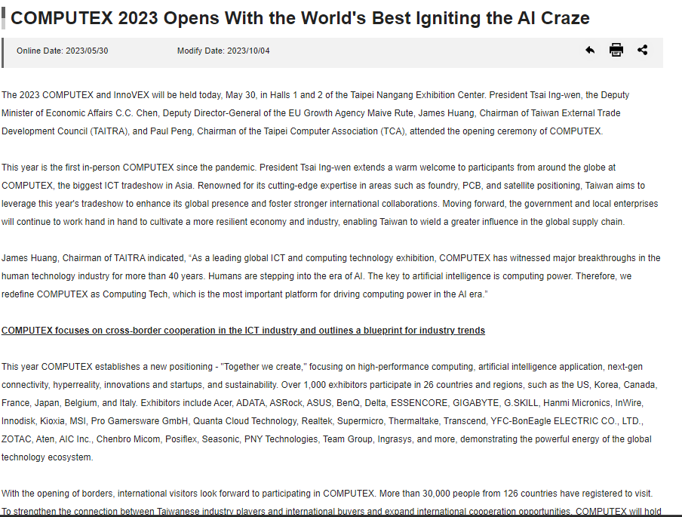
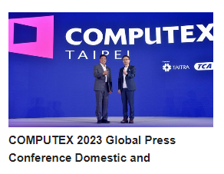
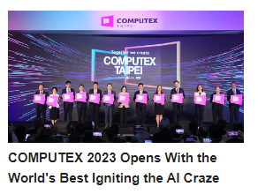


Slide 10

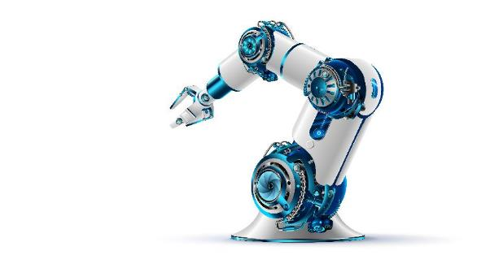
2
Global rankings:
5
Machine Tool
4
80% of products are exported
Wood Working
Annual Output: US$46.4 billion
6
Textile
6
Plastics & Rubber
2
Shoemaking
In terms of annual export value
Source: TAMI, TWMA

Slide 11
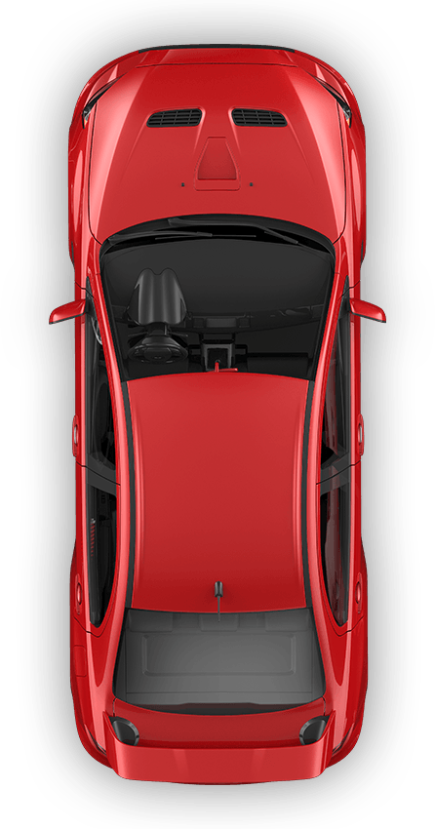
Automobile – Electrical Vehicle
3
Future Trends
Energy Saving
Environmentally Friendly
Lightweight Materials
Modular Design
Safe & Smart
Use of ultra-high strength steel : carbon fiber, composite metals
Modular component design for cross different brands such as VW, REE & MIH
Sensor, computing & various components increase active and passive safety
Connected vehicle enables infotainment, navigation & payments
Driven by Government Initiatives, Incentives
and people eco-awareness
Improved efficiency and accuracy in motors, sensors and BMS

Slide 12
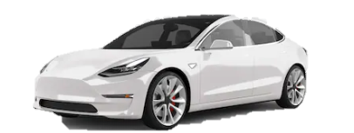

3
Automobile – Electrical Vehicle
Breakdown of EV
Vehicles
Motor
Electronics
Battery
Passenger Car
Foxtron, Yulon, China Motor,
Bus
Master, RAC, Tangeng, Tron-e
Two- and Three-wheeled
Aeon, Ahamani, China Motor, Gaius, Gogoro, Kuan Mei, Kymco, Motive Power, SYM
Motor Component and Material
Hota , Rich Electric , CSC ,Taigene, TATUNG,Tai-I
Motor Module
TECO, FUKUTA, Shihlin Electric, STARS, RICH ELECTRIC, CHENG CHANG
Motor System
Chroma, Foxtron, Jimpower
System
Chimei, Qisda, E-Lead, FIH, Mobiletron, Orange, Whetron
Radar
Cubtek, TungThih
Power Supply
AcBel, DELTA
Lens
Asia Optical, Calin
Battery Cell and Material
BenQ, CorMax, MECHEMA, CAEC, CSCC
Formosa Plastics Group , Co-Tech, Chang Chun
Battery Module
C-Tech, SMP, E-One, Amita Technologies, PIHSIANG, CHANG HONG, Digi-Triumph
Dynapack, J.S Power, Masterhold, Simplo
Battery Management System
Chroma , Mobiletron, DELTA, Han-win
Testing
Charging
Battery Test Solution
Chroma
Motor Testing Solution
MICROTEST
CHEN TECH ELECTRIC (motor testing solution)
System and Integrator
YES, Noodoe, eTreego, Xmight
Station
FORTUNE ELECTRIC，DELTA, PHIHONG, Greatenergy, LITE-ON
Charging Equipment
K.S. Terminals，SINBON, DELTA Well Shin Group, Solteam

Slide 13
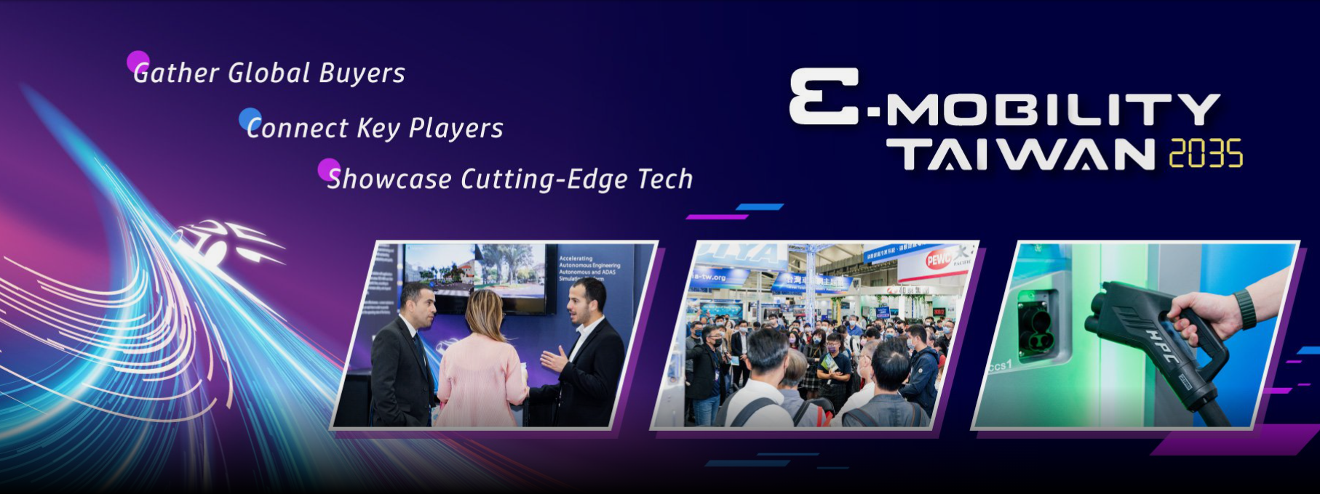
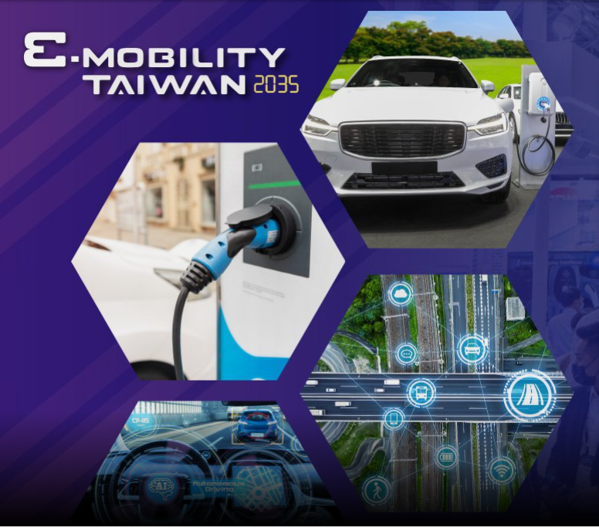
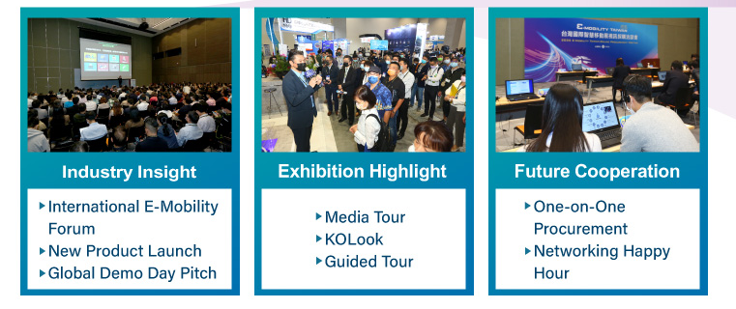

Slide 14
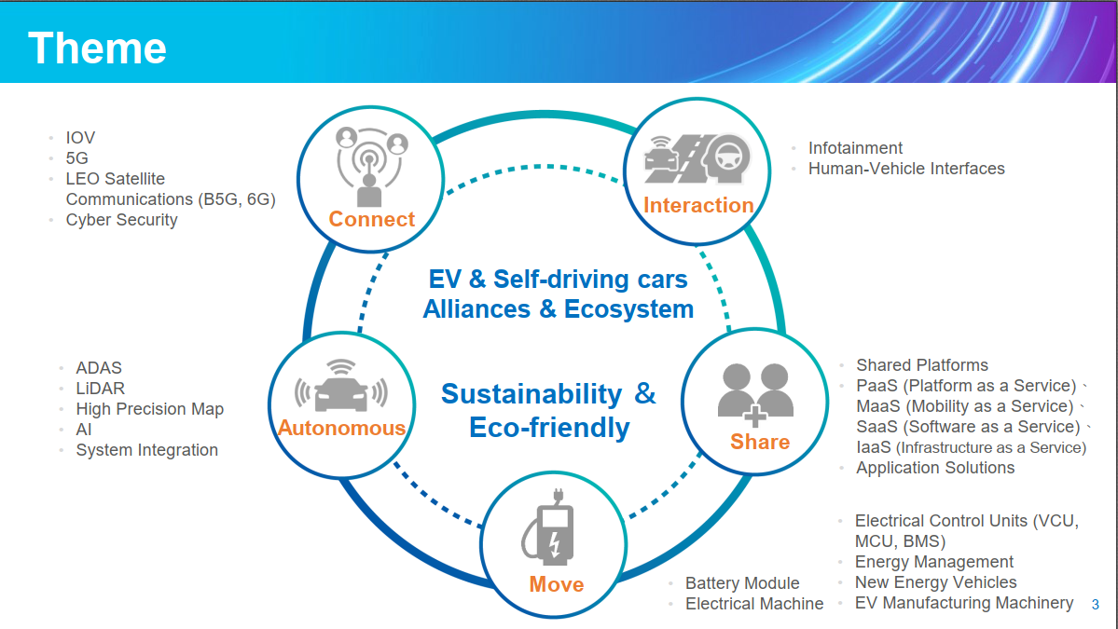

Slide 15
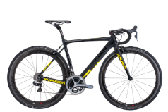









4
6
Bicycle
Taiwan exported 1.7 million complete bicycles annually,
42.2% of which are e-bikes
Global No.1 Companies
Bicycle Brand
Chain
Bicycle Saddle
High-end Wire
High-end Frame
Suspension
Tires
Handlebars and Seatposts
Rims

Slide 16
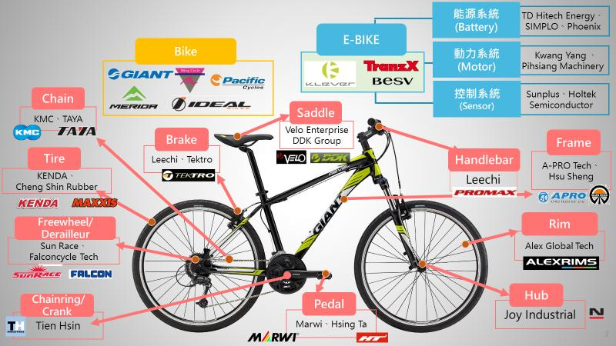
4
5
Bicycle
Breakdown of Bicycle

Slide 17
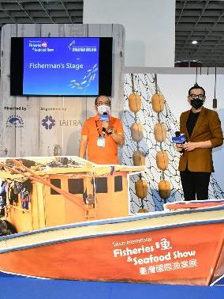
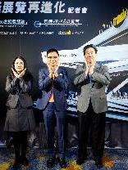
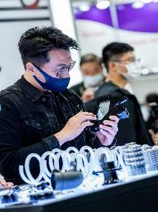
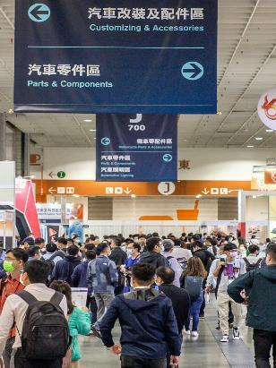
3
TAIWAN SERVICES

Slide 18


















TAIWAN Trade Shows
1
Hybrid
Online & Offline
24 International Trade Shows in 2024
Physical Only
TAIPEI PLAS
COMPUTEX
ShoeTech
2024
Feb.
Mar.
Apr.
May
Jun.
Jul.
Sep.
Oct.
Fastener Taiwan
TIWW
TAIPEI AMPA
FOOD TAIPEI
Taiwan
Innotech Expo
AutoTronics Taipei
FOODTECH TAIPEI
Energy Taiwan
Giftionery
BIO/PHARMATECH TAIWAN
TAITRONICS &
AIoT Taiwan
TAIPEI PACK
WOOD TAIWAN
TAIWAN HORECA
2035
E-Mobility
Taiwan
Kaohsiung
Food Show
18

Slide 19
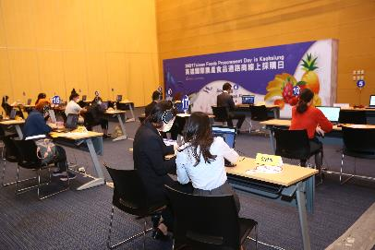
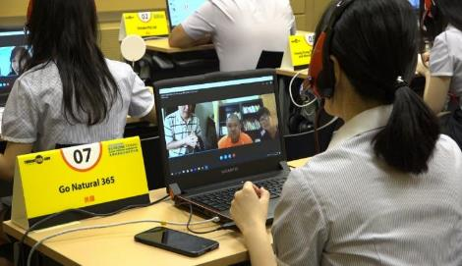
Business Meetings
3
Connecting international buyers and Taiwan suppliers
9,712
Meetings in 2021
3,939
Visits from worldwide in 2021
19

Slide 20
Taiwan Trade Center, Sofia
For further support, please contact:
Mitko Dimitrov – International Cooperation Expert
Phone : +359 2 4899737
mail : sofia2@taitra.org.tw

